Slide 1
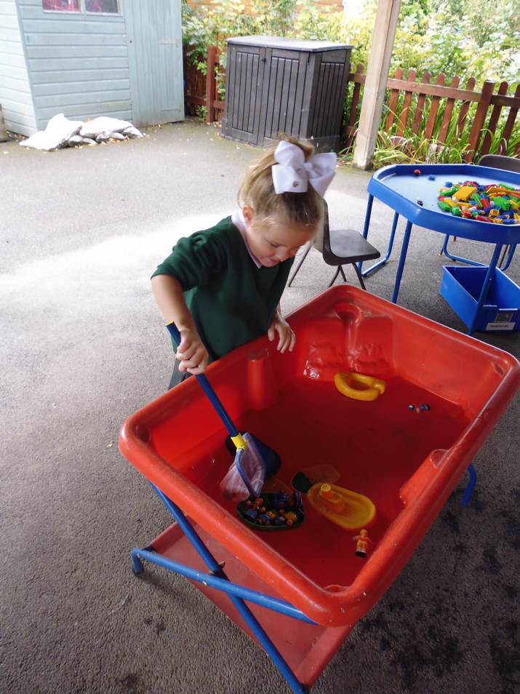
Phonics and Reading
Meldreth Primary School 2017

Slide 2
Some definitions…..
A phoneme is the
smallest unit of sound
in a word.
A grapheme is the letter(s)
representing a phoneme.
t ai er

Slide 3
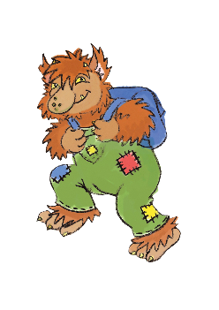

Tricky Troll Words
There are some common words which are not decodable using phonics, this means pupils have to simply learn to recognise and recall them.
Phase 2 Tricky Troll words: I no go to the
We call these words Tricky Troll
words.

Slide 4
Letters and Sounds
Teach children how to hear and say sounds.
Daily teaching of letters, letter names, the sounds they make and how to write them.
Help children to build a sight vocabulary of common words
We teach the skills of reading and spelling
How to blend sounds to read words and segment words into sounds in order to spell them.

Slide 5
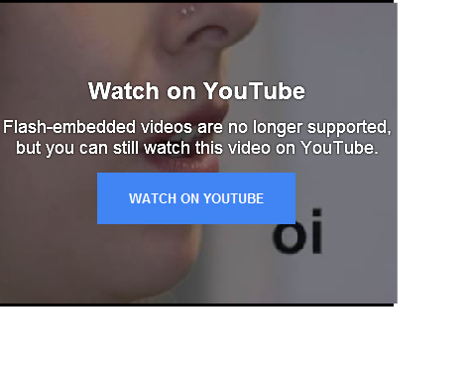
Articulation
Does it really matter how phonemes are pronounced?
Some children pick up the skill of blending very quickly even if the phonemes are not cleanly pronounced. However, we have found that for other children pronouncing the phonemes in, for example, cat as ‘cuh-a-tuh’ can make learning to blend difficult. It is therefore sensible to articulate each phoneme as cleanly as possible.

Slide 6
Teaching approaches
Order and pace
Flexibility
Making a good start
Multi-sensory- not worksheet based
Teaching sequence

Slide 7
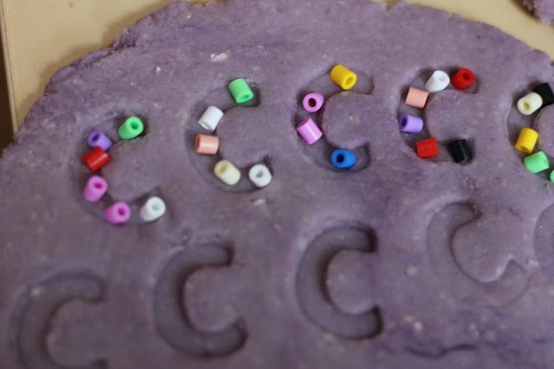

Multi Sensory approach
Children need lots of opportunity to play with the letter shapes, in the sand, water, magnetic letters, on the computer.
Phonemes can be introduced alongside actions for a multisensory approach
Notes:
Go through set of Phase 2 phonemes with action cards.

Slide 8
Teaching sequence
Phase One - environmental, rhythm and rhyme, oral blending and segmenting. This continues throughout all of the phases.
Phase Two- introduce grapheme-phoneme correspondence (Foundation Stage). Introduces 19 grapheme-phoneme correspondence. Orally blend and segment Vowel Consonant (VC) and Consonant Vowel Consonant (CVC) words Songs (oral), what’s in the box, buried treasure
Phase Three teach one of each 44 phonemes in order to read and spell regular words. Some digraphs

Slide 9
Teaching sequence
Phase Four teach children to read and spell words containing adjacent consonants consolidates, applying to reading unfamiliar text and in spelling
Phase Five teaching children to recognise and use alternative ways of pronouncing graphemes and spelling phonemes (throughout Year One) for example ‘ai’ (rain) same as ‘ay’ (pay) ‘a-e’ (cake). Also those that look the same for example ‘ow’ (cow) and ‘ow’ (snow)
Phase Six children become fluent readers and increasingly accurate spellers. They shift from learning to read to reading to learn. They are taught past tense, suffixes (ful, er, est, ly, es, s, ness).

Slide 10
Definitions
Phonics - broad term
Phoneme - smallest unit of sound c-a-t
Grapheme - symbol of phoneme ai igh th
Digraphs - 2 letter graphemes (2 letters making 1 phoneme) sh ea
Trigraphs - 3 letter graphemes igh
Split digraph - letter has come between 2 letter digraph cake
Segmenting - breaking words into phonemes (to spell)
Blending - building words from phonemes (to read)

Slide 11
Teaching approaches
Storytime Phonics
Fishing for phonemes
Hopscotch phonics
Noisy letters
What’s in the box
Washing line
Bingo
Websites- phonicsplay, ictgames
Classroom provision supports the application of phonic knowledge and the opportunity to apply it.
Since 2012 a new ‘phonics check’ has been completed nationally at the end of Year One

Slide 12
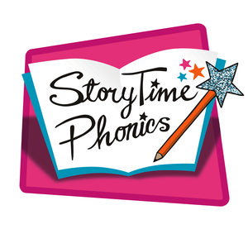

All of our phonics teaching is embedded within the context of real books.
Each sound is taught through a real story book written by some of the best-loved authors, and the follow up activities are multi sensory, making the learning meaningful and engaging.
This approach also gives us the opportunity to engage with inspiring story books and cover comprehension skills.
For example, s will be taught through the story ‘My Pet Snake’.
Notes:
Show ‘s’ card, book and share some of the activities.

Slide 13
Sound buttons
Look at the words and decide how many phonemes are in each word
Tip- cat has 3

Slide 14
Word | Can you segment the sounds in these words?
sun | s | u | n
shelf | sh
dress
think
ring
rabbit

Slide 15



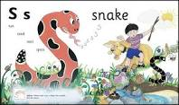

Reading in school
Emphasis in school is on teaching reading skills specifically through guided reading sessions, as well as class teaching.

Slide 16
Helping your child at home
A little goes a long way- 10 minutes 4/5 times a week is ideal.
Try to avoid busy nights.
Find a comfortable spot away from distractions or possible interruptions.
Children often enjoy reading the same book over and over again - try to stay interested as the repetition will build confidence.
Read to your child. Build vocabulary and understanding of story structures alongside phonics

Slide 17
Reading at home
Explore the front cover
Walk through the book first
Share the reading
(assisted blending, my turn, your turn)
Read the book several times. 3 times to avoid the ‘limp-a-long’ 1) decode 2) comprehension 3) story teller’s voice

Slide 18
When children become stuck
Don’t jump in too quickly!
Give children time to think and encourage them to use all the available information
Phonics first ‘sounding out’
Re-read the sentence until you reach the unknown word then use the first sound in that word together with the picture
Refer back to high frequency flashcards (Star words)
If your child is still unable to read the word, then you read it. Ensure that your child re-reads the sentence correctly.
Understanding text (reading comprehension) is the ultimate aim.

Slide 19

Questions?
If you have any questions or concerns about phonics or reading throughout the year, please do not hesitate to come and speak to us.

