Slide 1
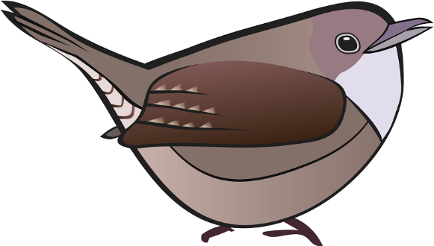
Good Morning Wren Class!
Tuesday 26th January 2021
How are you?

Slide 2
Let’s start
Would you rather…
have a magic carpet that flies or your own personal robot?
be able to fly or be invisible?
play in the snow in the mountains or sand at the beach?

Slide 3
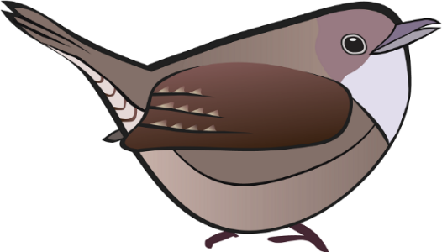
Morning Job

Slide 4
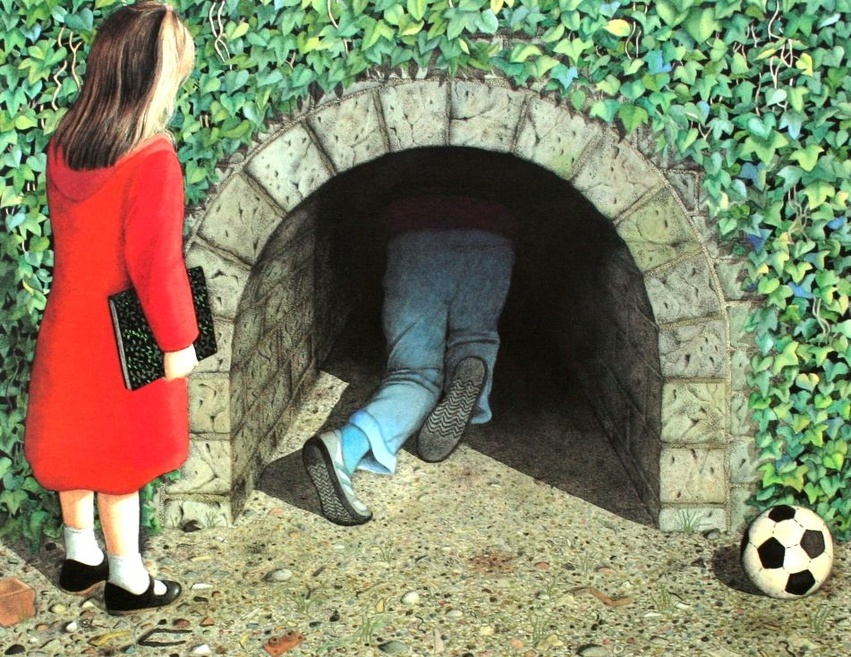
Reading
What if Rose hadn’t gone in the tunnel after Jack?
How would the story be different?

Slide 5
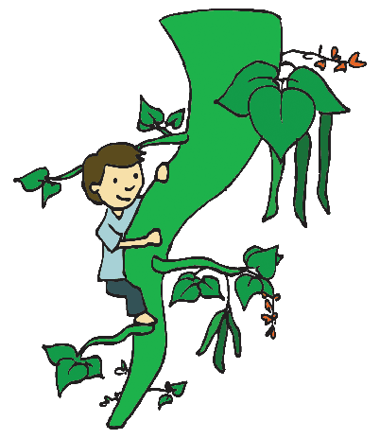
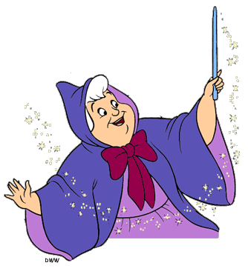
English
L.O.: to plan an alternative ending.
We are going to twist the text!
We all know traditional tales well, but what would happen if we changed the ending of a well-known tale?

Slide 6
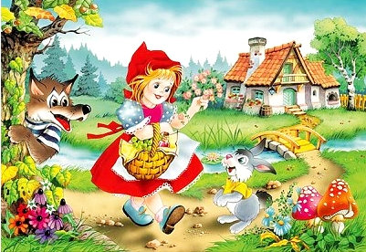
The story we all know:
Red Riding Hood walks through the woods to go and visit her grandmother...
A big bad wolf gets to grandma’s house first, locks her in the closet and dresses in her clothes...
When Red Riding Hood arrives she knows something isn’t right with the ‘what big teeth you have...’ conversation...
A wood cutter shows up just in the nick of time to save red riding hood from being eaten up by the wolf...

Slide 7
What could we change and how would it affect the outcome of the story?

Slide 8
What if?
As Little Red approached grandma’s cosy cottage, she opened the wicker basket and grabbed her glasses. Mum had taken her to the opticians last week and she was still getting used to wearing them.
With her spectacles in place, Little Red could make out claw marks on grandma’s front door. Before stepping in to the house, Little Red called the police.

Slide 9
Another example:
This one was written by a year 2 pupil at another school.
(https://app.pobble.com/works/dcec5863)

Slide 10
Another example:
This one was written by a year 2 pupil at another school.
(https://app.pobble.com/works/dcec5863)

Slide 11
Choose a traditional tale…
Snow White
or
Jack & the Beanstalk

Slide 12
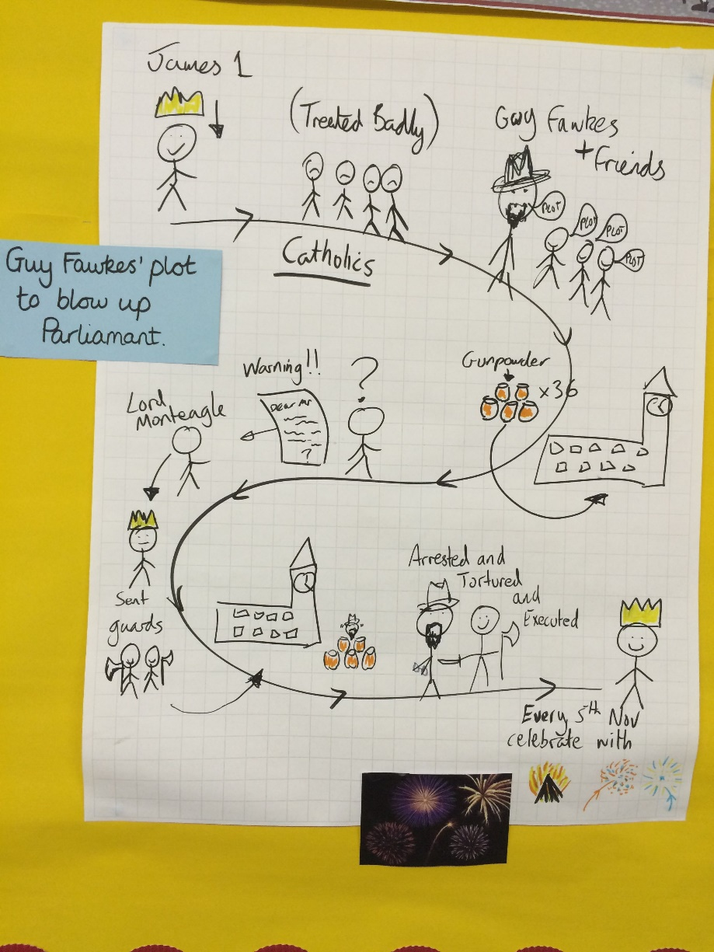
Plan your changes…

Slide 13
Magic 10
L.O.: to know and use number bonds to 19.

Slide 14
Number bonds to 19
0 + 19 = 19
1 + 18 = 19
2 + 17 = 19
3 + 16 = 19
4 + 15 = 19
5 + 14 = 19
6 + 13 = 19
7 + 12 = 19
8 + 11 = 19
9 + 10 = 19
10 + 9 = 19
11 + 8 = 19
12 + 7 = 19
13 + 6 = 19
14 + 5 = 19
15 + 4 = 19
16 + 3 = 19
17 + 2 = 19
18 + 1 = 19
19 + 0 = 19

Slide 15
L.O.: to know and use number bonds to 19.
Today, we are going to create number bond paper chains.
Pick a number bond.
Choose two colours to show your number bond.
When you have finished, make sure to stick
a card on your chain and write the number bond.

Slide 16
Maths
L.O.: to make equal groups - grouping.

Slide 17
L.O.: to make equal groups – grouping.
Play coconut multiples: https://www.topmarks.co.uk/times-tables/coconut-multiples
Try the 3x tables.

Slide 18
There are 10 in total. There are 2 in each group. How many groups? ______
5

Slide 19
There are 8 in total. There are 2 in each group. How many groups? ______
4

Slide 20
There are 12 in total. There are 3 in each group. How many groups? ______
4

Slide 21
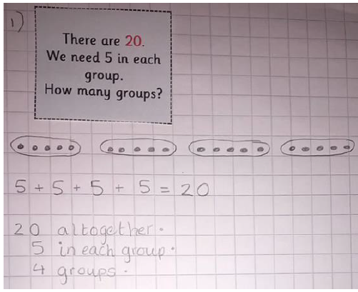
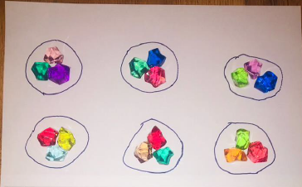
L.O.: to make equal groups – grouping.
You do not have to print out the sheets for this activity.
Choose and perform the instructions from the cards.
You can use items from home to show the groups or draw groups in your books.

Slide 22
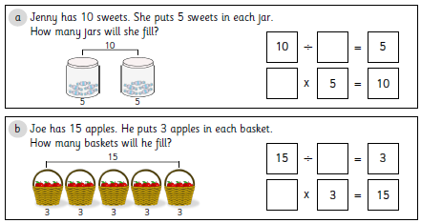
L.O.: to make equal groups – sharing.
An additional challenge…

Slide 23
L.O.: to make equal groups – sharing.
An additional challenge…

Slide 24
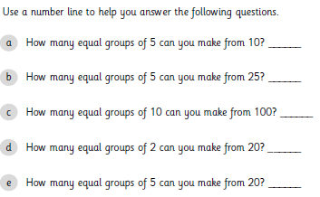
L.O.: to make equal groups – sharing.
An additional challenge…
You can use your number line or hundred square to help you with these.

Slide 25
L.O.: to make equal groups – sharing.
An additional challenge…

Slide 26
Magic Spell
This week, our spelling rule is change the y to an I when adding –es to nouns and verbs.
fly flies
try tries
cry cries
fry fries
reply replies
copy copies
carry carries
baby babies
story stories
activity activities
berry berries
jelly jellies
family families

Slide 27
Magic Spell
The word singular means just one of something.
For example, a dog or a fox.
The word plural means more than one of something.
For example, dogs or foxes.

Slide 28
Magic Spell
What is a verb?
A verb is an action word.
You cannot have a complete sentence without a verb.
For example:
Little Red likes to walk through the woods.
Goldilocks made a mess of the bedroom.

Slide 29
Magic Spell
If your verb has a consonant before the –y, usually we add -ies.
study studies
If your verb doesn’t have a consonant before the –y, we just add –s.
play plays

Slide 30
Word Hunt
Can you find these words in your reading books?
Can you find any other examples of verbs ending in –ies?
fly flies
try tries
cry cries
fry fries
reply replies
copy copies
carry carries

