Slide 1

PINS Session 1 Sensory Differences Workshop 2025

Slide 2
Who are we and what is a Parent Carer Forum?
Every county has a Parent Carer forum this is a statutory duty. We are Pinpoint, Cambridgeshire’s Parent Carer forum.
Parent carer voices must be heard
Chapter 1 of the SEND Code of Practice reminds us that parents/carers are the experts on their child/ren and must be involved in decision-making
We do not carry out individual casework or support work, but we will signpost to those who can.
We are aiming for a system that is us and us rather than them and us!

Slide 3
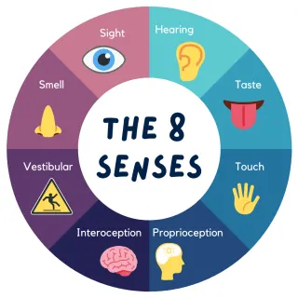
Senses
How many senses do we have?
5
7
8
Or more
We will be thinking about 8 senses in the workshop today.
Thinking about a neurodiverse friendly home. What might we need to consider?
Few mins to discuss
https://mindmate.org.uk/neurodiversity-information-hub/neurodiversity-characteristics/sensory-processing-nd/

Slide 4
A child’s sensory experience of visiting a shopping centre…can you make it to the end?
Click here
How we sense our world – the 7 senses!
Click here

Slide 5


Big cup
Little cup
Hypo responsive (under)
May need lots of movement, changes in colours etc
Hyper responsive (over)
Maybe easily overwhelmed by noise, light or other sensory inputs
Each of the senses can be represented by a different cup size. For example, some children my have a big cup for noise enjoy lots of different noises but other may have a small cup for noise and find it uncomfortable and makes it hard for them to concentrate and feel safe.

Slide 6

Activity discuss
Do you think your child has a big or little cup . . . .
when it comes to noise?
when it comes to bright light?
when it comes to pain?
when it comes to strong flavours?
when it comes to strong smells?
When it comes to movement?
Imagine a typical morning/day for a child with a small cup?
Imagine a typical morning/day for a child with a big cup?

Slide 7
Be your own detective, be curious.
Have a look around the room you’re in or just take the time to think about the spaces, rooms in your home.
Think about how your child or young person with sensory needs might experience the room you’re in or kitchen or the living room.
Are the lights very bright in the room?
Are any of the rooms very echoey or noisy?
Is there an uncluttered quieter space anywhere?

Slide 8
Creating a neurodiverse friendly home
Minimise potentially overwhelming sensory experiences at home
Noise
Lighting
Temperature
The space
Smells
Colours/ decoration
Textures fabrics

Slide 9
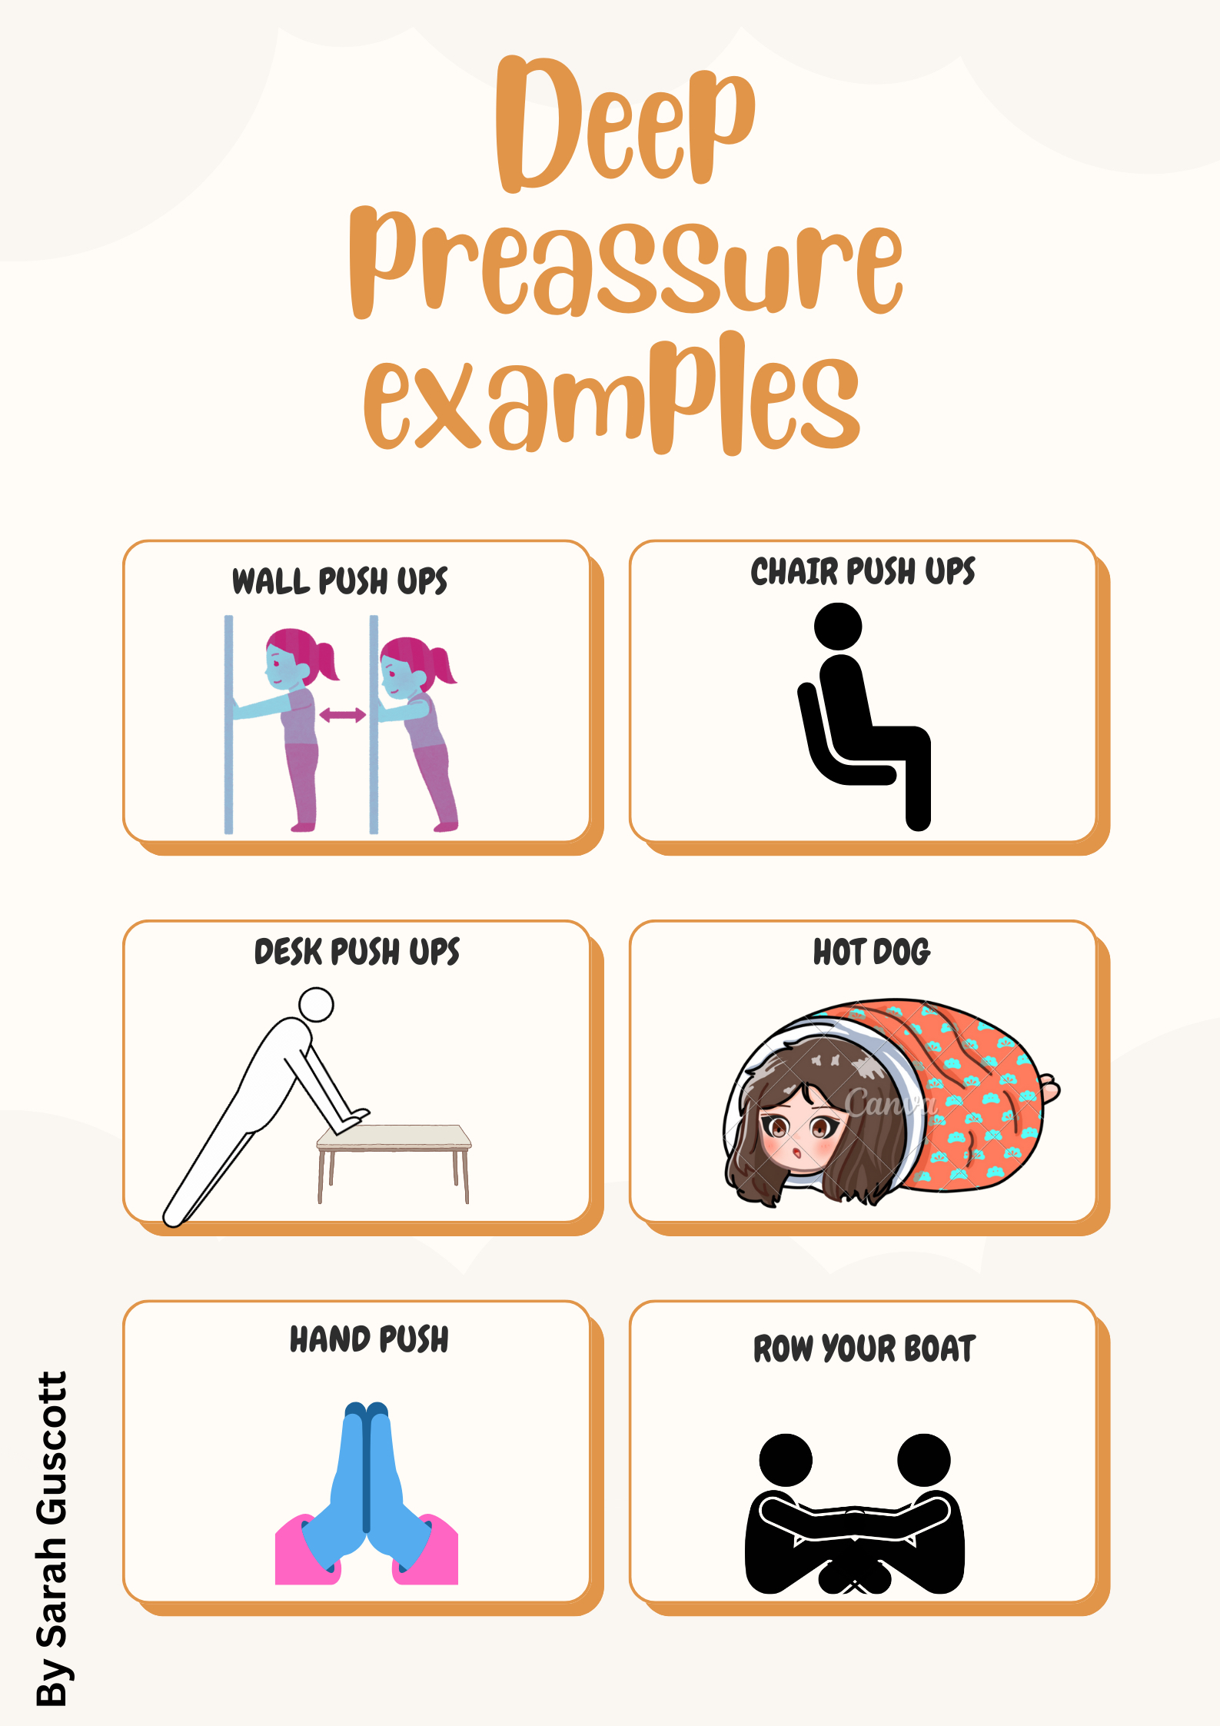
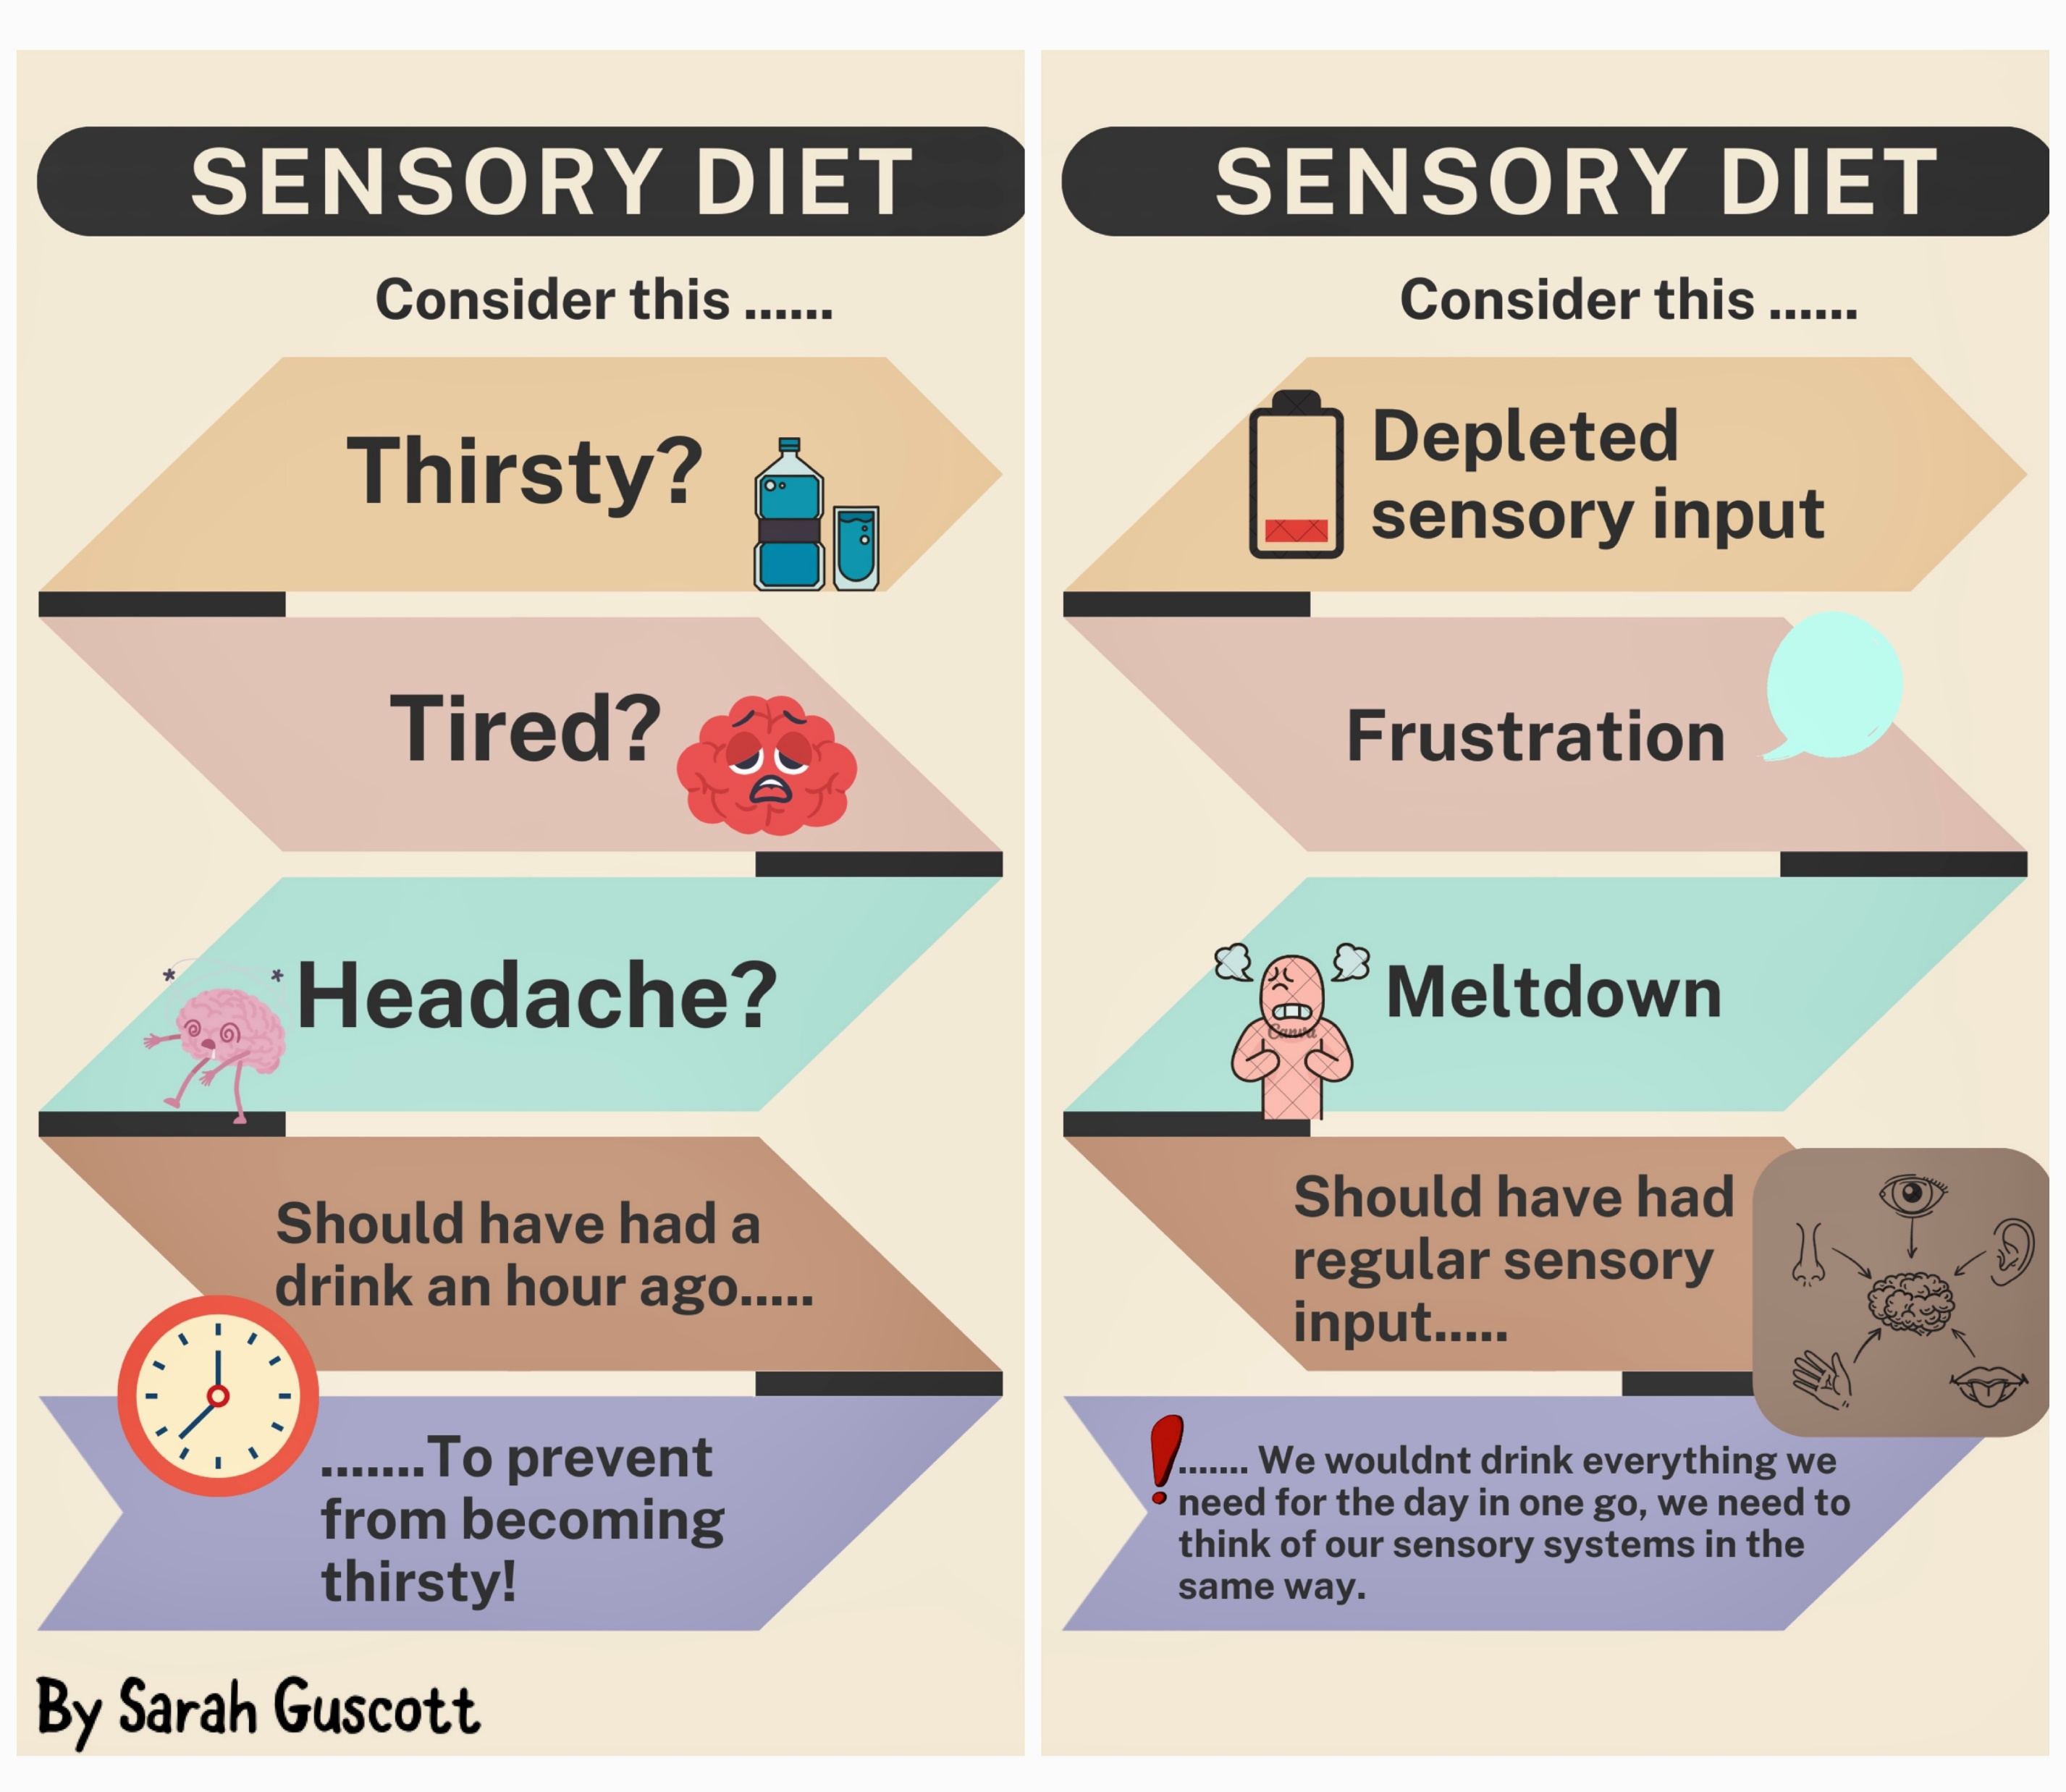
What is a sensory diet?
A sensory diet is a term used to describe a schedule or programme of activities to help a child manage the demands from their sensory environment.
A sensory diet doesn’t refer to what a child or young person is eating.
A sensory diet may often come as a recommendation from an Occupational Therapist (OT) as a strategy, they are a tool and must not be used as reward or consequence.

Slide 10
Fidget/sensory tools
Fidget tools comes in various shapes, sizes, and textures and are designed to promote movement while encouraging active learning and listening.
Fidgets can be purchased or made and shouldn’t produce noise (particularly for use in the classroom. Fidgets should be small and able to be used without causing distractions to others.
Fidget balls, stress balls, bike chain fidgets, and fidget cubes are just some of the examples of fidget toys.
Fidget tools can aid students with sensory processing disorders, ADHD, or even students who exhibit stress and anxiety.
Fidgets keep the body active, making room for the student to better engage in communication, reading, and listening.
What’s your preference, why?

Slide 11
Why Do Fidget Tools/Aids Help?
Tactile input, movement, and sensory integration have been proven to help control a restless body and improve learning in the classroom.
Children who can’t seem to stay in their seats will benefit from fidgets because it will encourage quiet body movement while still providing high sensory input.
Movement is important to learning because it requires both the left and right brain hemispheres to be active.
Minds becomes more organised the more sensory input they receive.
Hands are particularly important to self-regulating the nervous system, which makes small fidget toys valuable for classroom learning.
How could/do you use a fidget tool with your child/ren?
Discuss

Slide 12
Resources
Cambridgeshire Children’s Occupational Therapy Service
Cambridgeshire Children's Occupational Therapy (link for website)
A webpage full of ideas, tips, videos and resources
Free Advice Line, Mondays and Thursdays 9.30-11am, Wednesdays 2.30-4pm
They advise on how to use sensory circuits for use at home with whatever you have handy, providing the principles of “Alerting, Organising, Calming” are kept to in the right order.
Example-sensory-circuit-info-and-ideas-for-home-STARS.pdf

Slide 13
More resources…
Learn Together Cambridgeshire – Ordinarily Available Provision Toolkit
Primary and Secondary SEND OAP Toolkit (link for all OAP toolkits)
Sensory and Physical (link for sensory OAP toolkit)
Links to the toolkits provided to support schools to meet children’s needs in school.
Includes a sensory checklist which can be used at home
Sensory processing & ND – MindMate (weblink)
Provides further information and strategies about sensory processing.

Slide 14

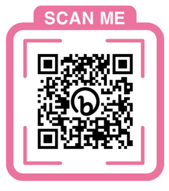
Neurodiversity Book - Pinpoint (pinpoint-cambs.org.uk)

