Slide 1
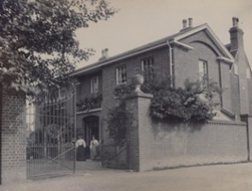
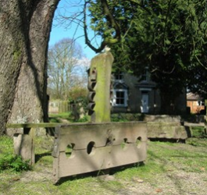
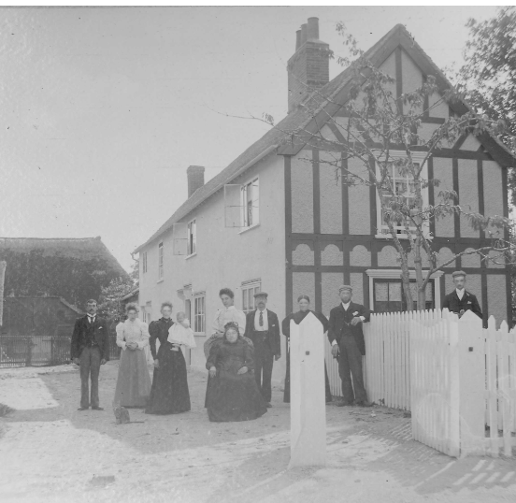
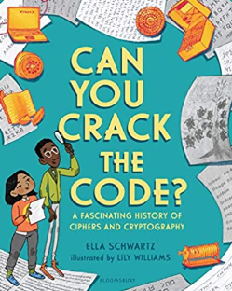
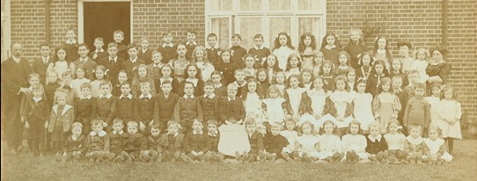
UKS2 Local History Study: Meldreth
Subject Specific Vocabulary |  |  | Exciting Books!
Village | A village is a group of houses and associated buildings in a rural area.
Rural | A rural area is an area of land in the countryside.
Bronze Age | The Bronze Age was a period of history that lasted from c.2500 until c.800 BC in Britain. | Sticky Knowledge
 |  | The name Meldreth means ‘mill stream’.
Commuters | A commuter is a person who travels some distance to work on a regular basis. Many adults in Meldreth are considered commuters.
 |  | Meldreth has been populated since at least the Bronze Age – a large Bronze Age hoard was found near Meldreth railway station a few years a go.
Stocks and whipping post | This was a type of Medieval punishment. You can still see the old stocks in Meldreth village centre.
 |  | Meldreth Primary school was founded in 1910 - over 100 years ago!
 |  | The train station in Meldreth has been running since the mid-1800s!
Evacuee | During WWII, many school children and mothers were sent away from London for their protection. They went to live in villages and towns across the UK.
 |  | Hope Folly became a Prisoner of War camp during WWI. A number of German prisoners were housed there.
 |  | During WWII, many children were evacuated from London to Meldreth.

